Slide 1
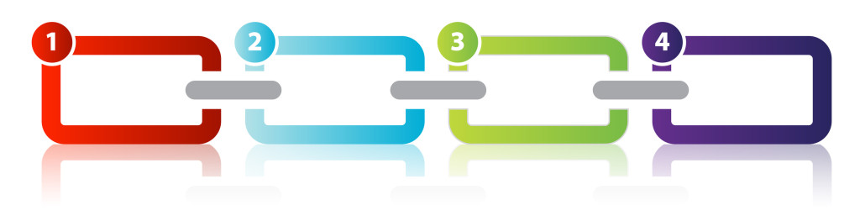
CHAIN OF RESPONSIBILITY

Slide 2
Definition
What is this?

Slide 3
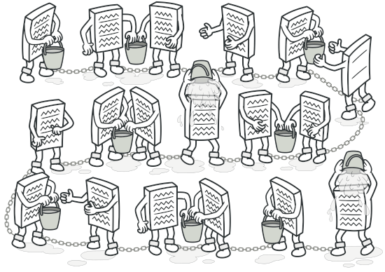
Definition
Chain of Responsibility is a behavioral design pattern that lets you pass requests along a chain of handlers. Upon receiving a request, each handler decides either to process the request or to pass it to the next handler in the chain.

Slide 4

Definition
Behavioral design patterns are concerned with algorithms and the assignment of responsibilities between objects.

Slide 5
Motivation
Why would we use this?

Slide 6
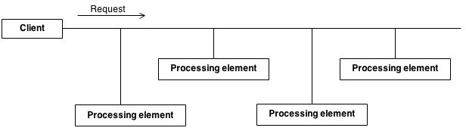
Problem
There is a potentially variable number of “handler” or “processing element” or “node” objects, and a stream of requests that must be handled. Need to efficiently process the requests without hard-wiring handler relationships and precedence, or request-to-handler mappings.

Slide 7
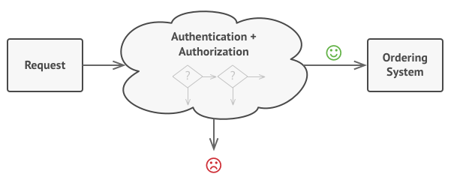
Problem

Slide 8
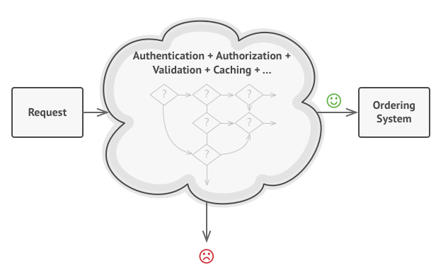
Problem

Slide 9
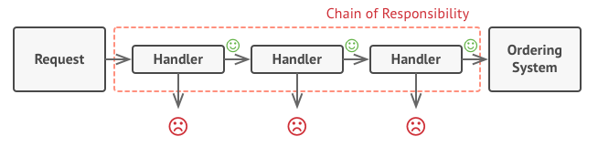
Solution
Encapsulate the processing elements inside a “pipeline” abstraction; and have clients “launch and leave” their requests at the entrance to the pipeline.

Slide 10
Examples
Where can we apply this?

Slide 11
School

Slide 12
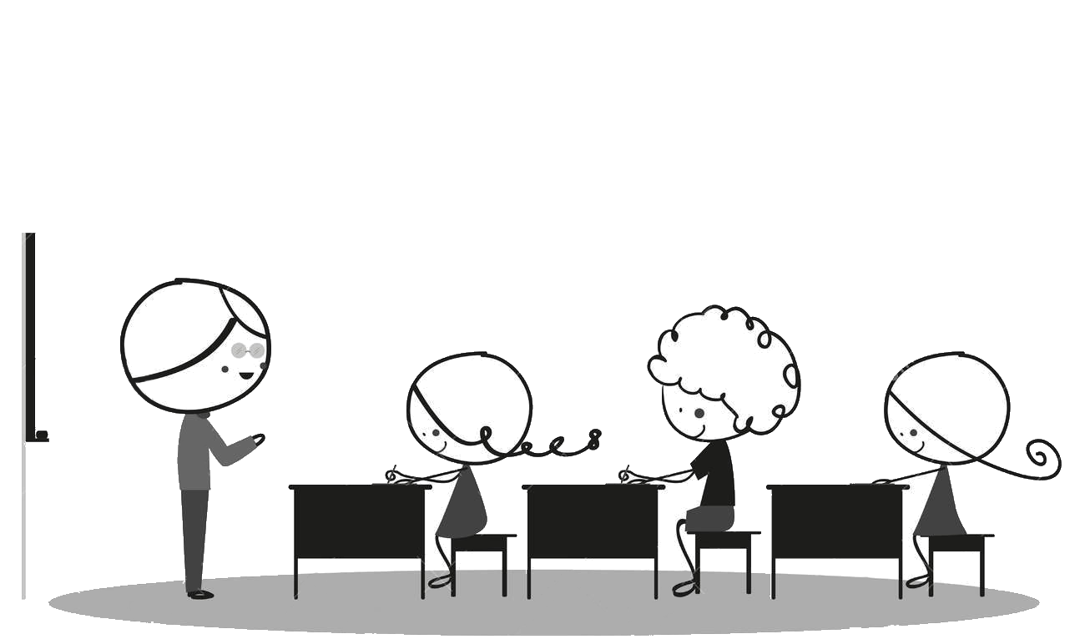
Example

Slide 13
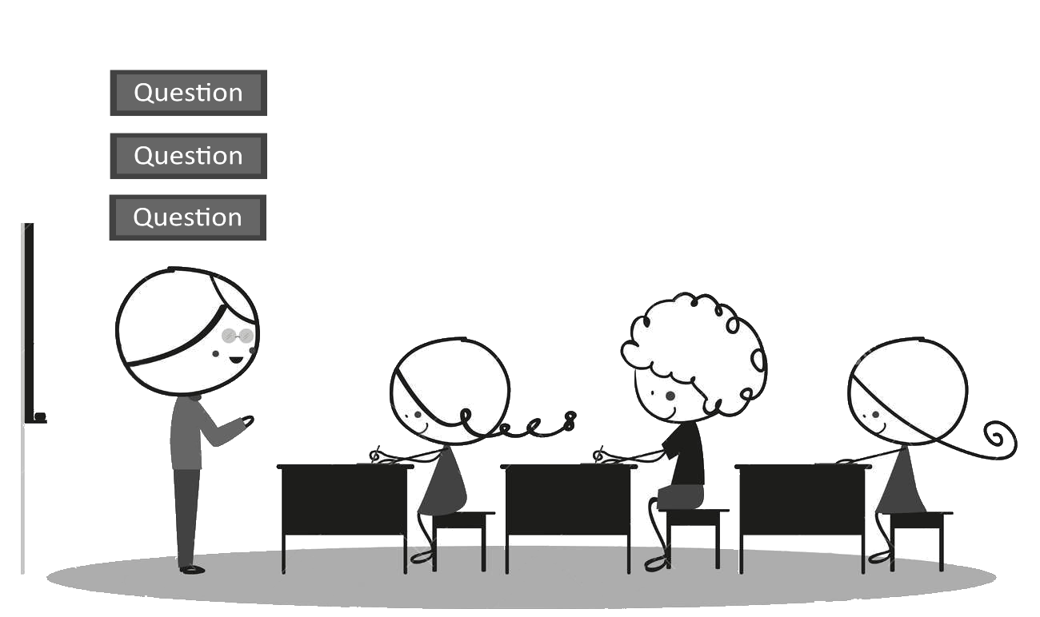
Example

Slide 14
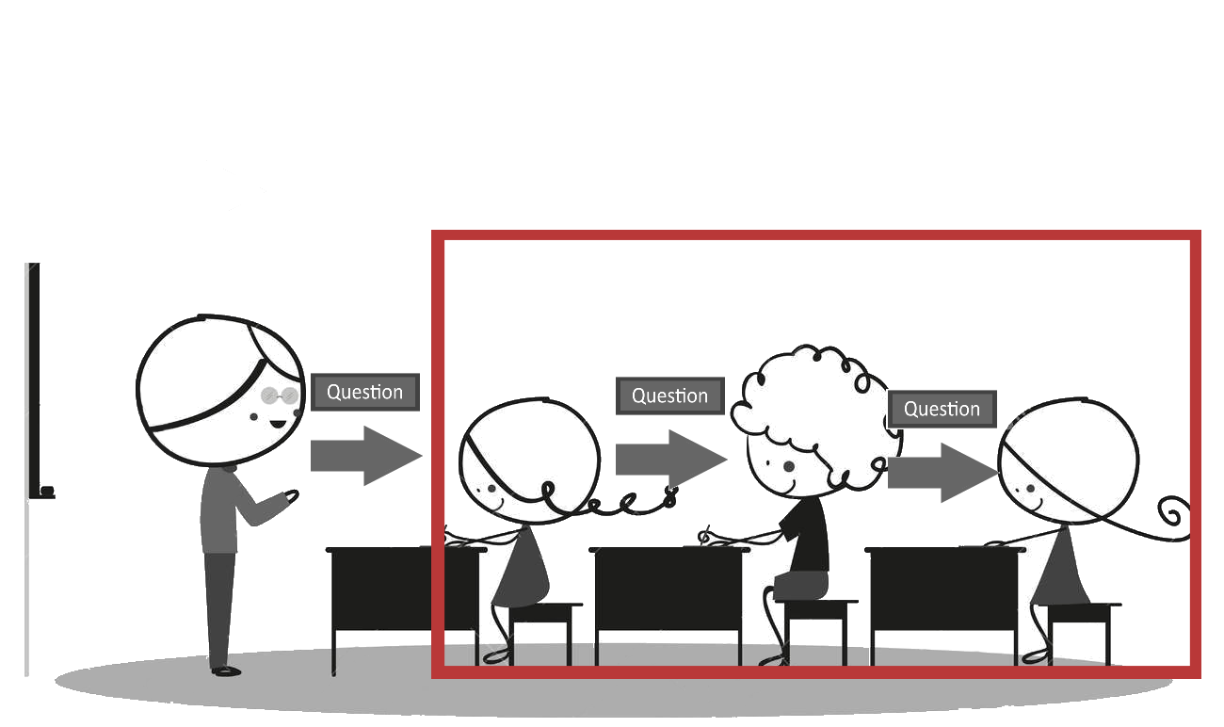
Example

Slide 15
ATM

Slide 16
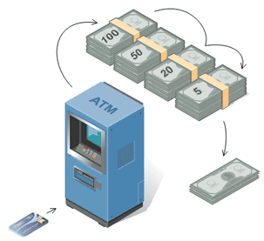
Example

Slide 17
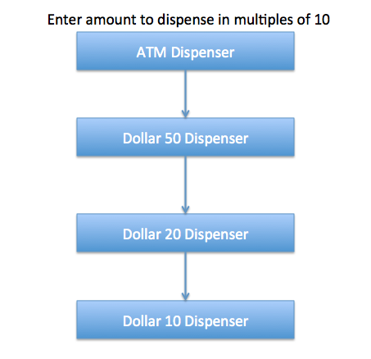
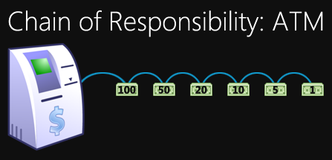
Example

Slide 18
Input Validation

Slide 19
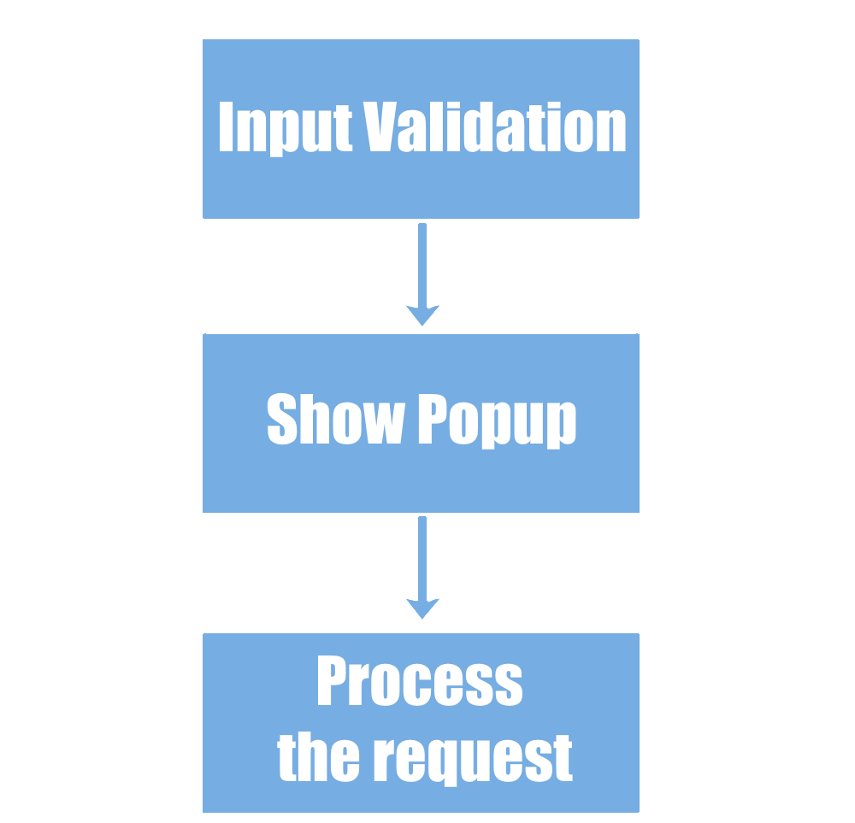
Example

Slide 20
Mail

Slide 21
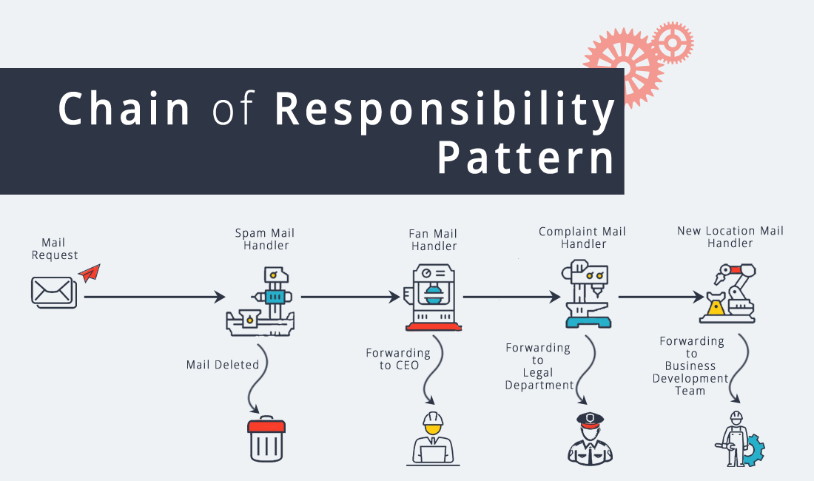
Example

Slide 22
Applicability
When should we use this?

Slide 23
Applicability
Where and when Chain Responsibility pattern is applicable:
When it’s essential to execute several handlers in a particular order
When the set of handlers and their order are supposed to change at runtime
When you want to decouple a request’s sender and receiver

Slide 24
Applicability
Where and when Chain Responsibility pattern is applicable:
When it’s essential to execute several handlers in a particular order
When the set of handlers and their order are supposed to change at runtime
When you want to decouple a request’s sender and receiver

Slide 25
Applicability
Where and when Chain Responsibility pattern is applicable:
When it’s essential to execute several handlers in a particular order
When the set of handlers and their order are supposed to change at runtime
When you want to decouple a request’s sender and receiver

Slide 26
Applicability
Where and when Chain Responsibility pattern is applicable:
When it’s essential to execute several handlers in a particular order
When the set of handlers and their order are supposed to change at runtime
When you want to decouple a request’s sender and receiver

Slide 27
Structure

Slide 28
Structure
Handler : This can be an interface which will primarily receive the request and dispatches the request to chain of handlers. It has reference of only first handler in the chain and does not know anything about rest of the handlers. (Linked list)

Slide 29
Structure
Handler : This can be an interface which will primarily receive the request and dispatches the request to chain of handlers. It has reference of only first handler in the chain and does not know anything about rest of the handlers. (Linked list)
Concrete handlers : These are actual handlers of the request chained in some sequential order. (a node in the linked list)

Slide 30
Structure
Handler : This can be an interface which will primarily receive the request and dispatches the request to chain of handlers. It has reference of only first handler in the chain and does not know anything about rest of the handlers. (Linked list)
Concrete handlers : These are actual handlers of the request chained in some sequential order. (a node in the linked list)
Client : Originator of request and this will access the handler to handle it.

Slide 31
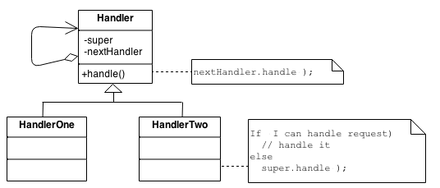

Diagram

Slide 32
The code
The fun part

Slide 33
Example
Only one receiver in the chain handles the Request

Slide 34
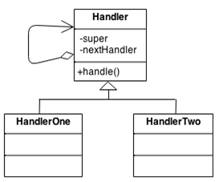
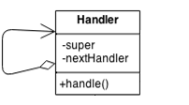
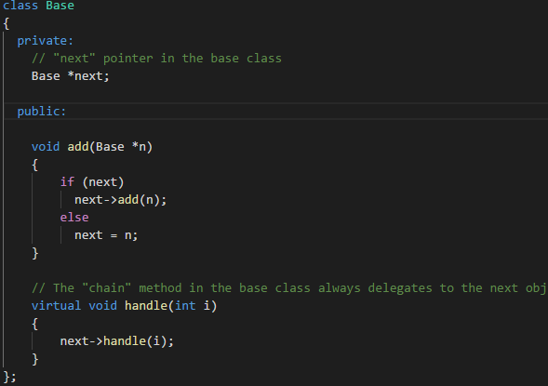

Slide 35
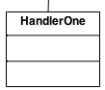
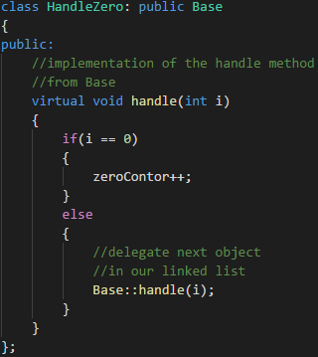
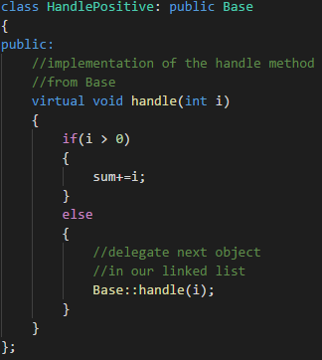
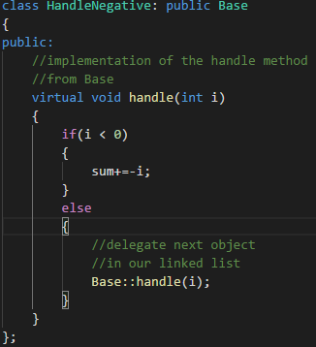

Slide 36
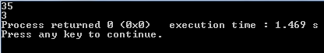
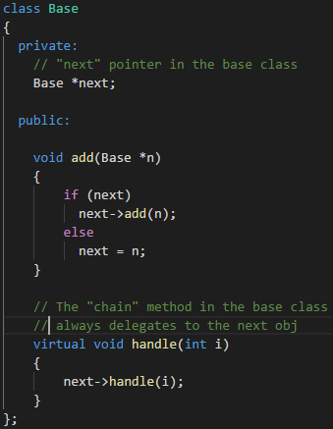
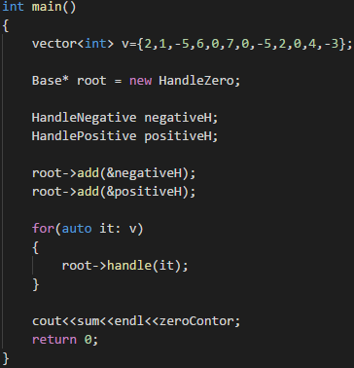

Slide 37
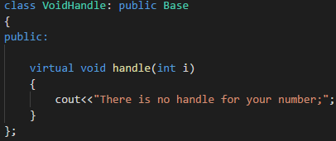

Slide 38
Example
One or more receivers in the chain handles the Request

Slide 39
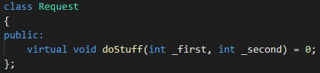
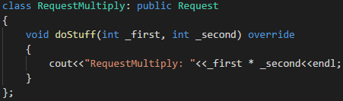
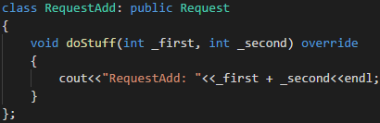


Slide 40
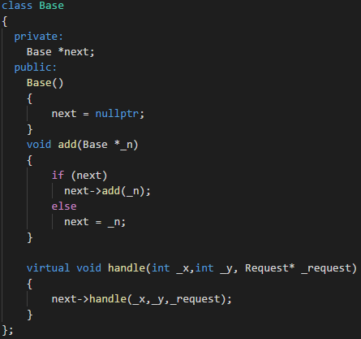
Old
New

Slide 41
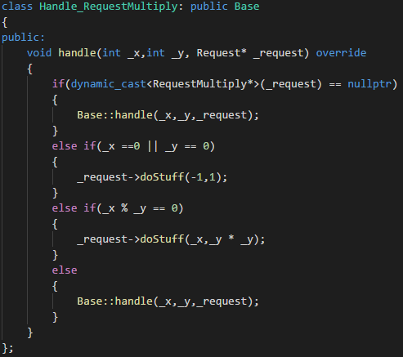
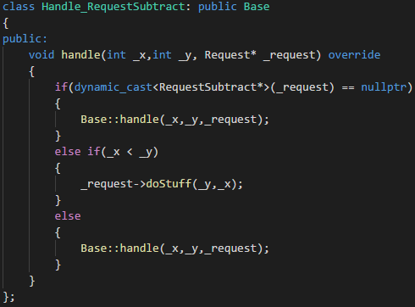
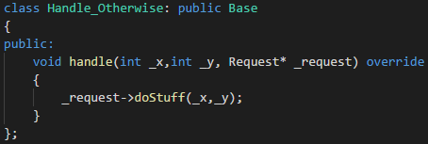

Slide 42
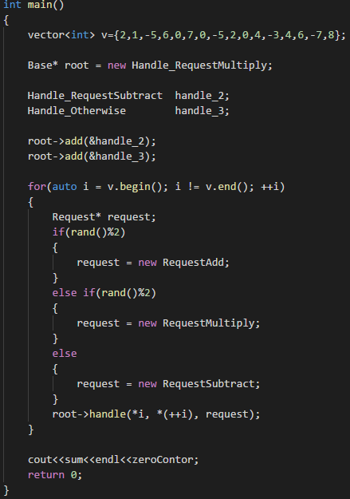

Slide 43
Conclusion
What we’ve learned today

Slide 44
Pros and Cons

Slide 45
Pros and Cons
You can control the order of request handling.

Slide 46
Pros and Cons
You can control the order of request handling.
Open/Closed Principle. You can introduce new handlers into the app without breaking the existing client code.

Slide 47
Pros and Cons
You can control the order of request handling.
Open/Closed Principle. You can introduce new handlers into the app without breaking the existing client code.
Single Responsibility Principle. You can decouple classes that invoke operations from classes that perform operations.

Slide 48
Pros and Cons
You can control the order of request handling.
Some requests may end up unhandled.
Open/Closed Principle. You can introduce new handlers into the app without breaking the existing client code.
Single Responsibility Principle. You can decouple classes that invoke operations from classes that perform operations.

Slide 49
Conclusion
What is Chain of Responsibility :

Slide 50
Conclusion
What is Chain of Responsibility : It’s a design pattern used to achieve loose coupling

Slide 51
Conclusion
What is Chain of Responsibility : It’s a design pattern used to achieve loose coupling
When it is good to use it :

Slide 52
Conclusion
What is Chain of Responsibility : It’s a design pattern used to achieve loose coupling
When it is good to use it : When you have a complex logic to handle requests

Slide 53
Conclusion
What is Chain of Responsibility : It’s a design pattern used to achieve loose coupling
When it is good to use it : When you have a complex logic to handle requests
Structure :

Slide 54
Conclusion
What is Chain of Responsibility : It’s a design pattern used to achieve loose coupling
When it is good to use it : When you have a complex logic to handle requests
Structure :

Slide 55

Questions
Any questions?

Slide 56

Thanks!
Thank you!

